Slide 1
Learning to summarize from human feedback

Slide 2
Overview of Text Summarization:
Extractive Summarization
Abstractive Summarization

Slide 3
Challenges in Text Summarization
Content Selection
Fluency and Coherence
Evaluation

Slide 4
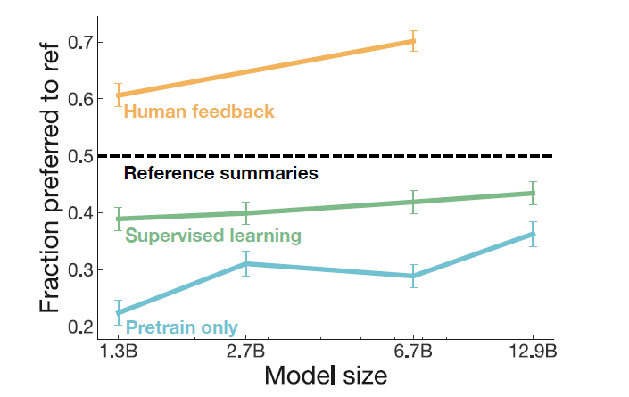

Slide 5
Supervised Model
Design
Evaluation Metric
ROUGE

Slide 6
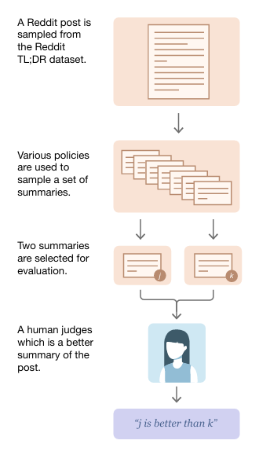

Slide 7
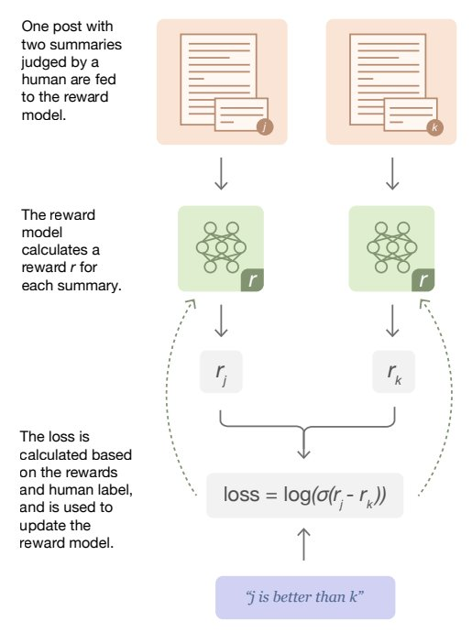

Slide 8
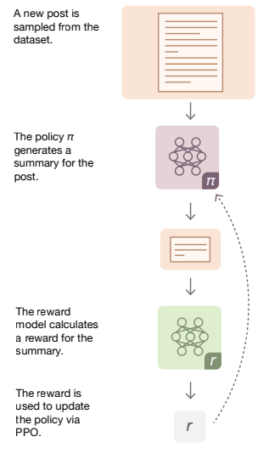
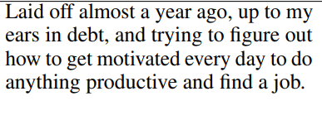
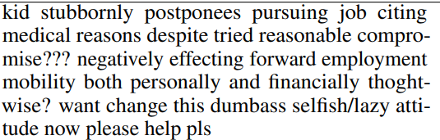

Slide 9
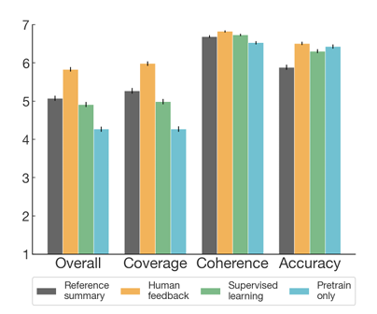
Evaluation of summary quality
Overall - the overall quality of summary
Coverage - how much important information from the original post is covered
Coherence - how easy the summary is to read on its own
Accuracy - to what degree the statements in the summary are stated in the post

Slide 10
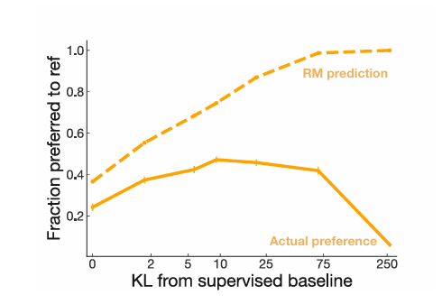
Reward Model optimizatioN

Slide 11
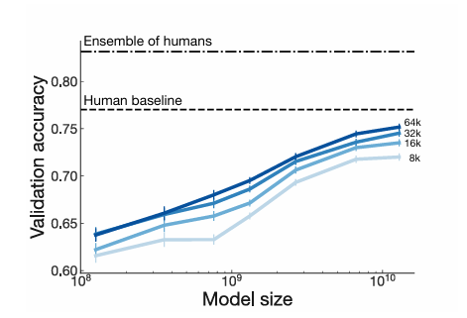
Effects of Model size

Slide 12
Conclusion
Limitations
Future Directions
Broader Impacts

Slide 13

Thank you
For donations:
Send sol to : BaX28t9yeZmgoKm2Q2dNduJFKRqAWL9zyoEv3GBAuYpu

